Slide 1

CSCI 466: Networks
Network Layer – Data Plane
Reese Pearsall Fall 2022
https://www.cs.montana.edu/pearsall/classes/fall2022/466/main.html
*All images are stolen from the internet
1

Slide 2
Announcements
NO CLASS this Friday (10/14) and next Monday (10/17)
You can always email/DM me if you have questions
Wireshark Lab 1 due TONIGHT @ 11:59 PM
If you work with a partner, both need to submit to D2L!
Extra Credit survey still available !!

Slide 3

Application Layer
Presentation Layer
*
Application Layer
Session Layer
*
Messages from Network Applications
Transport Layer
Network Layer
Physical Layer
Data Link Layer
Bits being transmitted over a medium
Physical Layer
*In the textbook, they condense it to a 5-layer model,
but 7 layers is what is most used

Slide 4

Application Layer
Presentation Layer
*
Application Layer
Session Layer
*
Messages from Network Applications
Transport Layer
Network Layer
Physical Layer
Data Link Layer
Bits being transmitted over a medium
Physical Layer
*In the textbook, they condense it to a 5-layer model,
but 7 layers is what is most used

Slide 5

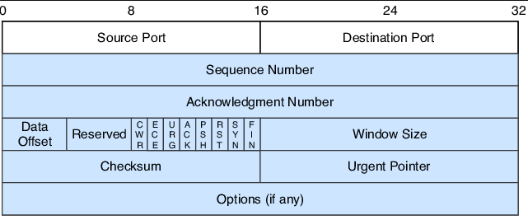
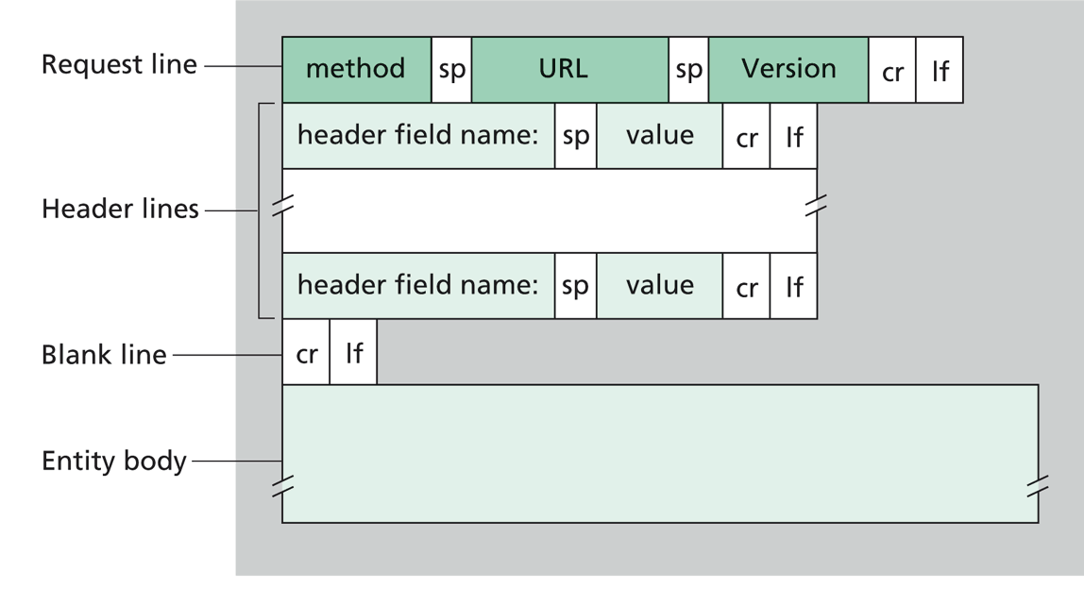
Application Layer
Our packet of information so far…
Transport Layer
“Segment”
Transport Layer Header
Message
Transport Layer Protocol
(ex. TCP)
Application Layer Protocol (ex. HTPP)

Slide 6
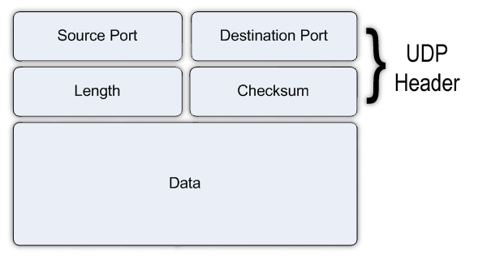
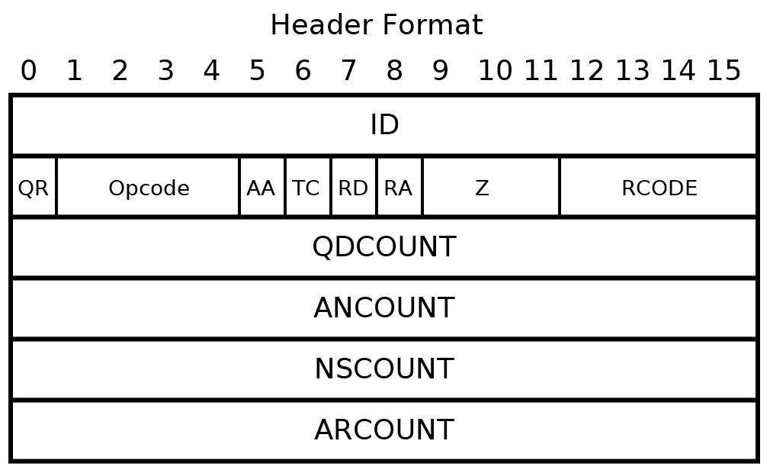
Application Layer
Our packet of information so far…
Transport Layer
“Segment”
Transport Layer Header
Message
Transport Layer Protocol
(ex. UDP)
Application Layer Protocol (ex. DNS)

Slide 7
Application Layer
We’ve only looked at protocols that are running on some host
Transport Layer
Network Layer
???

Slide 8

We will now shift our focus towards routers, or packet switches
In the network layer, we finally get to leave the host and adventure into the network

Slide 9
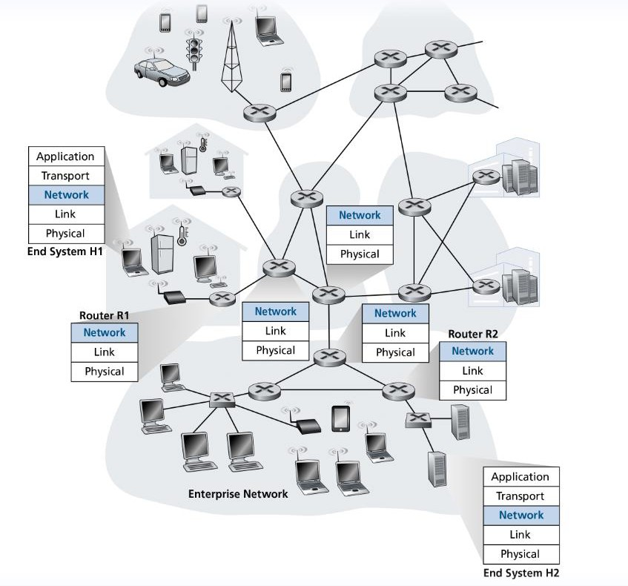
Routers do not have functionality for application & transport layer protocols

Slide 10
We will now shift our focus towards routers, or packet switches
Routing: determine route taken by packets from source to destination

Slide 11
We will now shift our focus towards routers, or packet switches
Routing: determine route taken by packets from source to destination
There is likely very many paths from one host to another! Which is the most efficient path?

Slide 12
We will now shift our focus towards routers, or packet switches
?
?
?
Which path should be taken?
Forwarding: move packets from router’s input to appropriate router output

Slide 13






Network Layer
Responsible for the delivery of data through a network
Forwarding
Routing

Slide 14
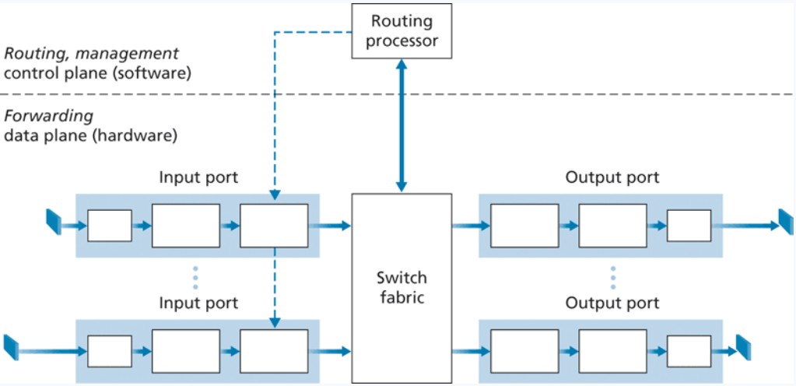
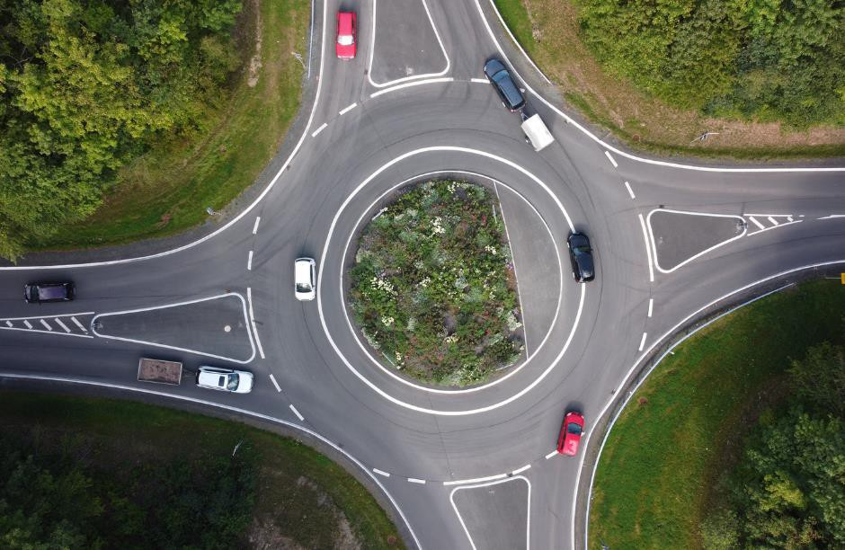
Router Architecture Overview
Destination-based forwarding
Forwarding decisions are based on the destination of the packet
Generalized forwarding
Forwarding decisions based on any set of header field values

Slide 15
Router Architecture Overview
INPUT PORT
Lookup, forwarding, queueing
Bits received
Bit-level reception (physical layer)
Link Layer Protocol
“Switching Fabric”
…
…
Such as over the wire or through the air
Next layer of OSI
model
Ex. Ethernet
Evaluate header field values, lookup output port using forwarding table in memory
Queueing will occur if datagrams arrive faster
than forwarding rate into the switching fabric

Slide 16
Router Architecture Overview
OUTPUT PORT
Storing, ready for send off
“Switching Fabric”
Link Layer Protocol
Send bits
To destination
…
…

Slide 17
Forwarding Techniques
Connection-less
does not require startup,
Has no idea where the final destination is
Routing Table
Address range | Interface (output link)
128.11.52.0 – 128.11.52.255 | 1
153.90.2.0 – 153.90.2.255 | 2
153.90.2.87 – 153.90.2.89 | 3
Lookup, forwarding, queueing
This routing table could get very big…
IP addresses need 32/64 bits of memory each
…
…

Slide 18





Forwarding Techniques
Connection-less
does not require startup,
Has no idea where the final destination is
Routing Table
Address range | Interface (output link)
128.11.52.0 – 128.11.52.255 | 1
153.90.2.0 – 153.90.2.255 | 2
153.90.2.87 – 153.90.2.89 | 3
Lookup, forwarding, queueing
Connection-oriented
Requires startup
Virtual Circuit Networks
…
…
VC identifier | Interface (output link)
22 | 1
13 | 2
5 | 3
Costly ☹

Slide 19
Forwarding Techniques
Longest prefix matching
Address range | Interface (output link)
11001000 00010111 00010*** ********* | 1
11001000 00010111 00011000 ********* | 2
11001000 00010111 00011*** ******** | 3
otherwise | 4
Lookup, forwarding, queueing
…
…
when looking for forwarding table entry for given destination address, use longest address prefix that matches destination address
examples:
DA: 11001000 00010111 000
10110 10100001
which interface? which interface?
DA: 11001000 00010111 000
11000 10101010

Slide 20

Forwarding Techniques
Longest prefix matching
Address range | Interface (output link)
11001000 00010111 00010*** ********* | 1
11001000 00010111 00011000 ********* | 2
11001000 00010111 00011*** ******** | 3
otherwise | 4
Lookup, forwarding, queueing
…
…
when looking for forwarding table entry for given destination address, use longest address prefix that matches destination address
These lookups need to happen in nanoseconds for our network to function
Ternary content addressable memories (TCAMs) are used in modern routers to do LPM
Cisco routers can carry millions of TCAM entries in their routers

Slide 21
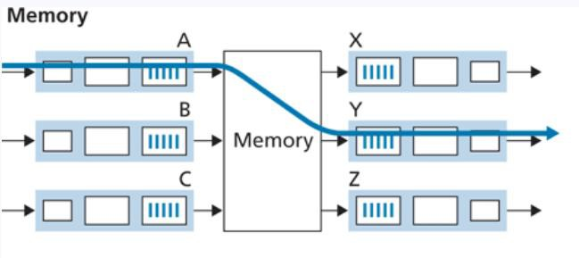
Fabric Switch and Switching
Switching fabric: Mechanism that forwards data from an input port to output port
Switching via memory:
Handled by a CPU (routing processor) Cannot forward data in parallel

Slide 22
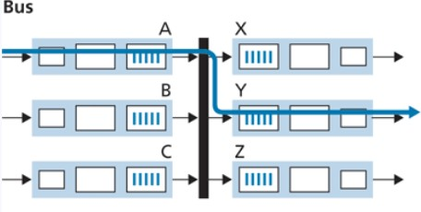
Fabric Switch and Switching
Switching fabric: Mechanism that forwards data from an input port to output port
Switching via memory:
Switching via bus:
Handled by a CPU (routing processor) Cannot forward data in parallel
Datagrams are prepended with a header
A “bus” transports input port datagrams to output ports
“keep going around the roundabout until you find your port”

Slide 23
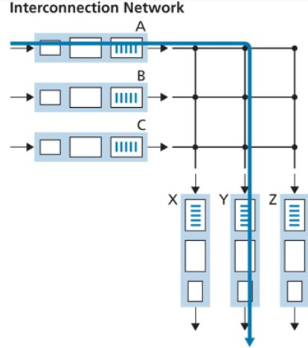
Fabric Switch and Switching
Switching fabric: Mechanism that forwards data from an input port to output port
Switching via memory:
Switching via bus:
Switching via network:
Handled by a CPU (routing processor) Cannot forward data in parallel
Datagrams are prepended with a header
A “bus” transports input port datagrams to output ports
A network of buses
“keep going around the roundabout until you find your port”
One shared bus, but can only fit one datagram

Slide 24
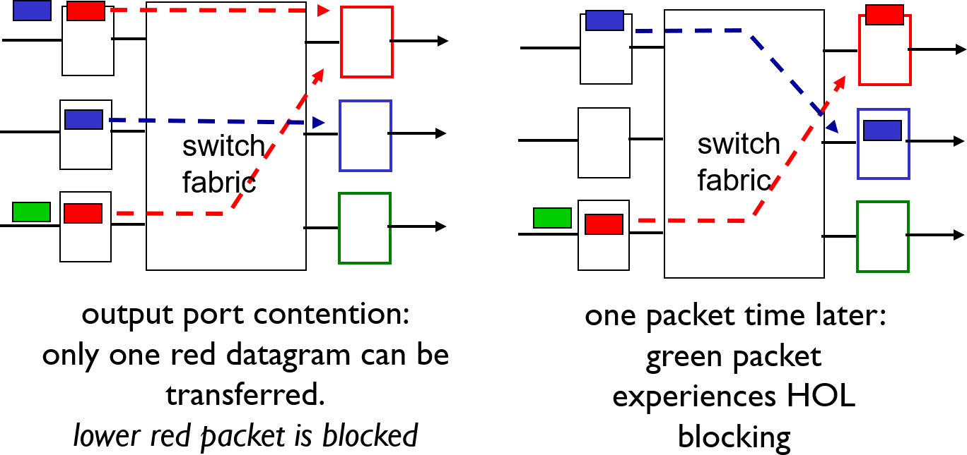
Input Queueing
fabric slower than input ports combined ➔ queueing may occur at input queues
Input ports
Output ports
Input ports
Output ports
Head-of-the-Line (HOL) blocking: queued datagram at front of queue prevents others in queue from moving forward

Slide 25

Output Queueing
OUTPUT PORT
Switching Fabric
Input
port
Storing, ready
for send off
Link Layer Protocol
Send bits
Input port
Incoming packets will have to wait for buffer space to become available
Possible solutions:
Remove a packet
Tail drop: drop arriving packet
Priority: drop/remove on a priority basis
Random: drop/remove randomly
Input port
Input
port

Slide 26
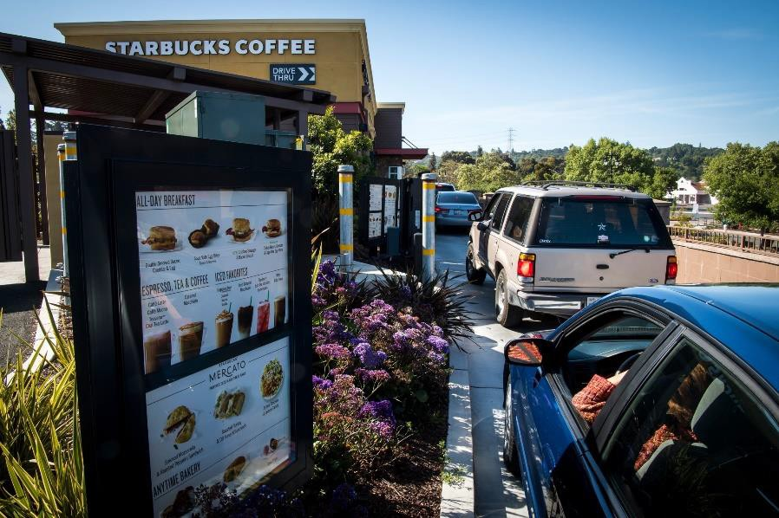
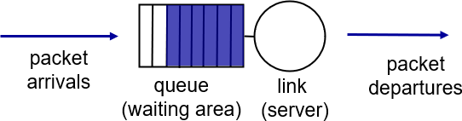
Packet Scheduling
Scheduling is used to determine the next packet to send on the link
FIFO (first in first out): Send in order of arrival to queue

Slide 27
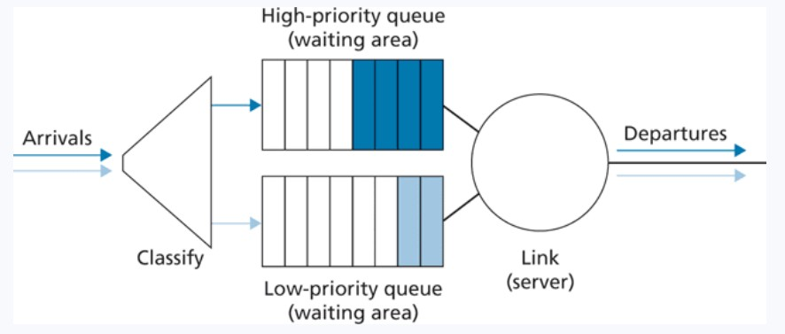
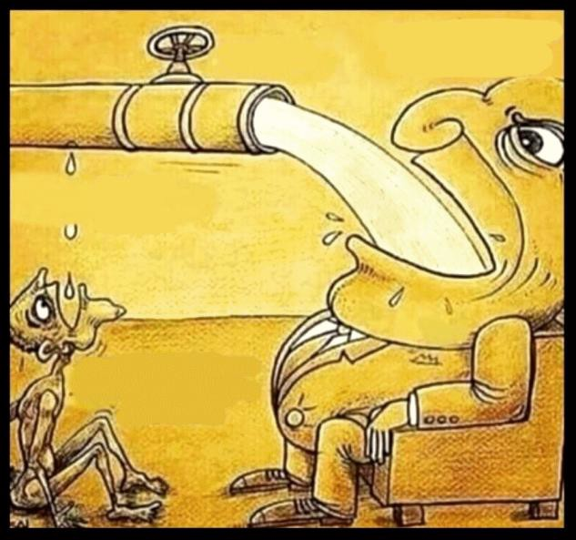
Packet Scheduling
Scheduling is used to determine the next packet to send on the link
Priority: packets are classified into priority classes. High priority = sent over link first

Slide 28
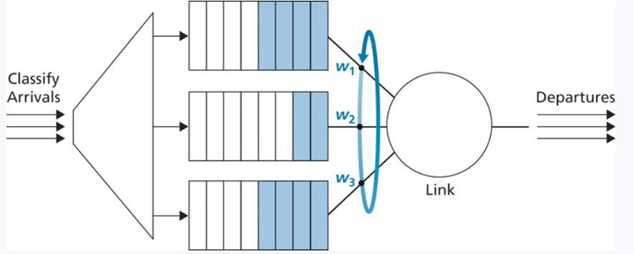
Packet Scheduling
Scheduling is used to determine the next packet to send on the link
Round robin weighted fair queueing: packets are classified into priority classes. Each class gets to send one packet during a “cycle”
Packet from the priority group gets sent
Packet from the middle class gets sent Packet from the plebian class gets sent

Slide 29

IP addressing, IPv4, and IPv6
https://www.rfc-editor.org/rfc/rfc791

Slide 30
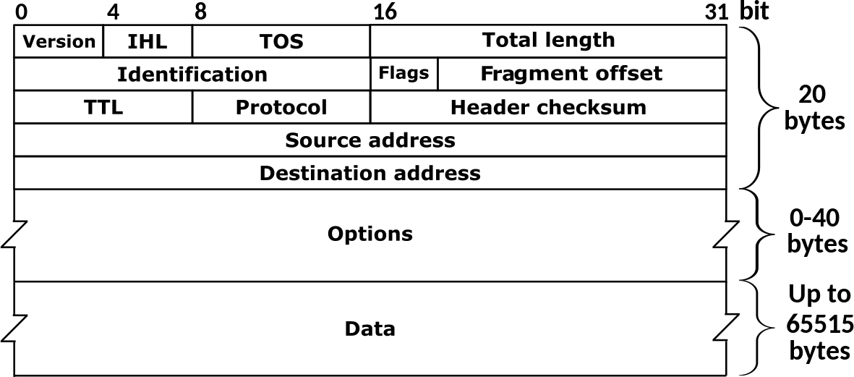
IPv4: 32-bit addresses (decimal)
Packets traversing through the network layer are referred to as a datagram. Each packet gets an IPv4/IPv6 header
192.149.252.76
IPv6: 64-bit addresses (hexademical)
3ffe:1900:fe21:4545::
Transport Layer Header
IP Header
Message
Transport
Layer Header
Message
Why do we need IPv6?
IPv4 Header

Slide 31
Announcements
NO CLASS this Friday (10/14) and next Monday (10/17)
You can always email/DM me if you have questions
PA2 due in one week (10/19)
Put time.sleep() commands after you send() to prevent weird timing errors

Slide 32
Packets traversing through the network layer are referred to as a datagram. Each packet gets an IPv4/IPv6 header
Transport Layer Header
IP Header
Message
Transport
Layer Header
TCP header = 20 bytes IP header = 20 bytes
Message
IPv4 Header

Slide 33
IP Address: Globally unique* 32 bit (4 byte) dotted decimal number assigned to interfaces on hosts and routers
193.32.216.9

Slide 34

IP Address: Globally unique* 32 bit (4 byte) dotted decimal number assigned to interfaces on hosts and routers
(1 byte = 8 bits)
193.32.216.9
4 bytes
4 bytes 4 bytes
4 bytes
128 | 64 | 32 | 16 | 8 | 4 | 2 | 1
1 | 1 | 0 | 0 | 0 | 0 | 0 | 1
128 + 64 + 1 = 193
193 = 11000001 in binary

Slide 35
IP Address: Globally unique* 32 bit (4 byte) dotted decimal number assigned to interfaces on hosts and routers
(1 byte = 8 bits)
193.32.216.9
=
11000001 00100000 11011000 00001001
How many addresses are possible with a 32 bit number? ~4 billion possible IPv4 addresses

Slide 36
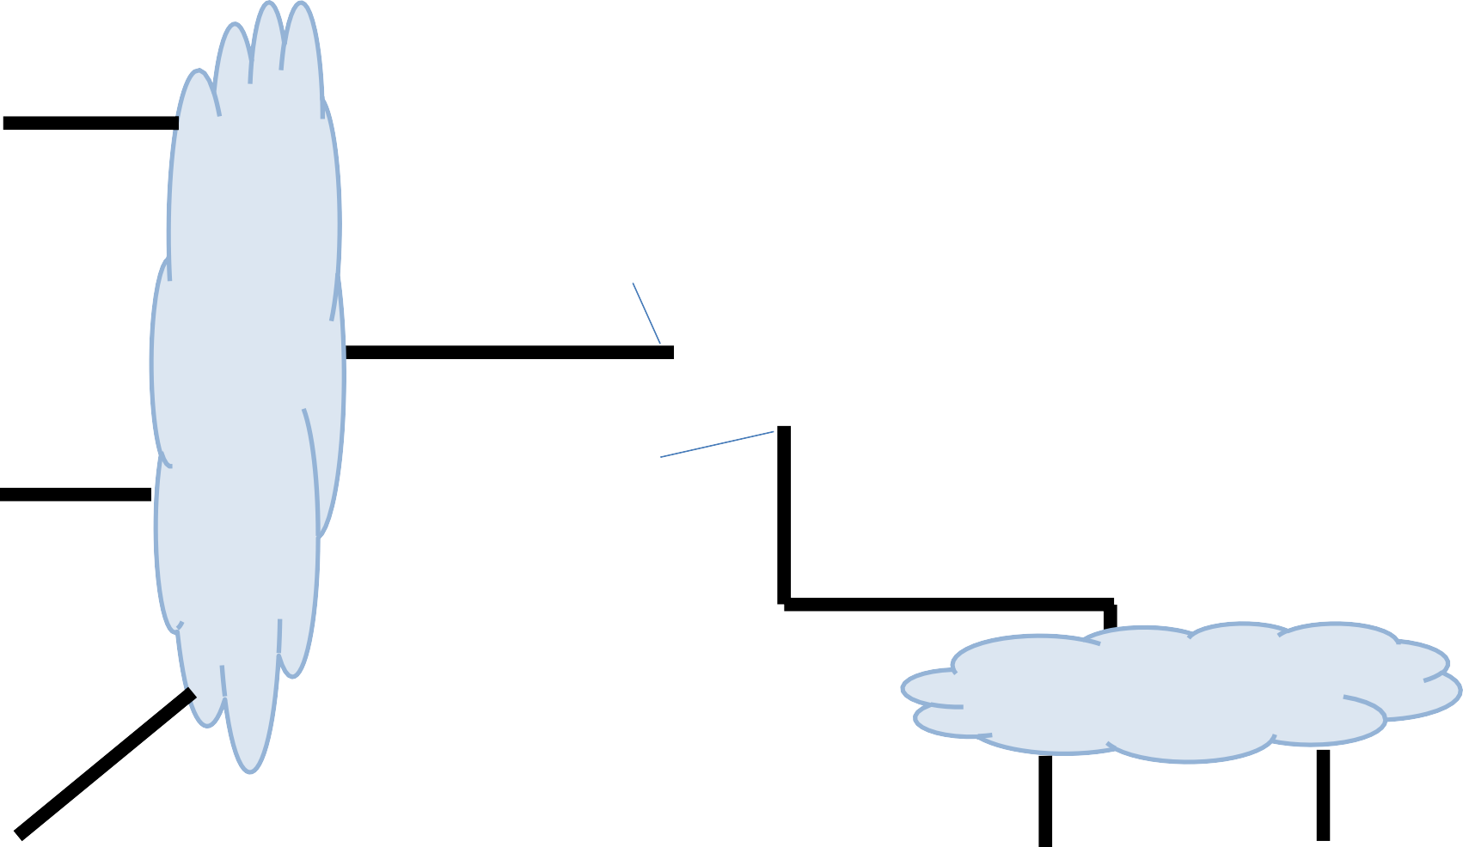
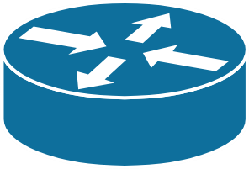
223.1.2.1
Subnet is a logical subdivision of an IP network
223.1.1.1
223.1.1.4
223.1.2.9
223.1.2.2
223.1.3.27
223.1.1.2
223.1.1.3
223.1.3.1
223.1.3.2

Slide 37
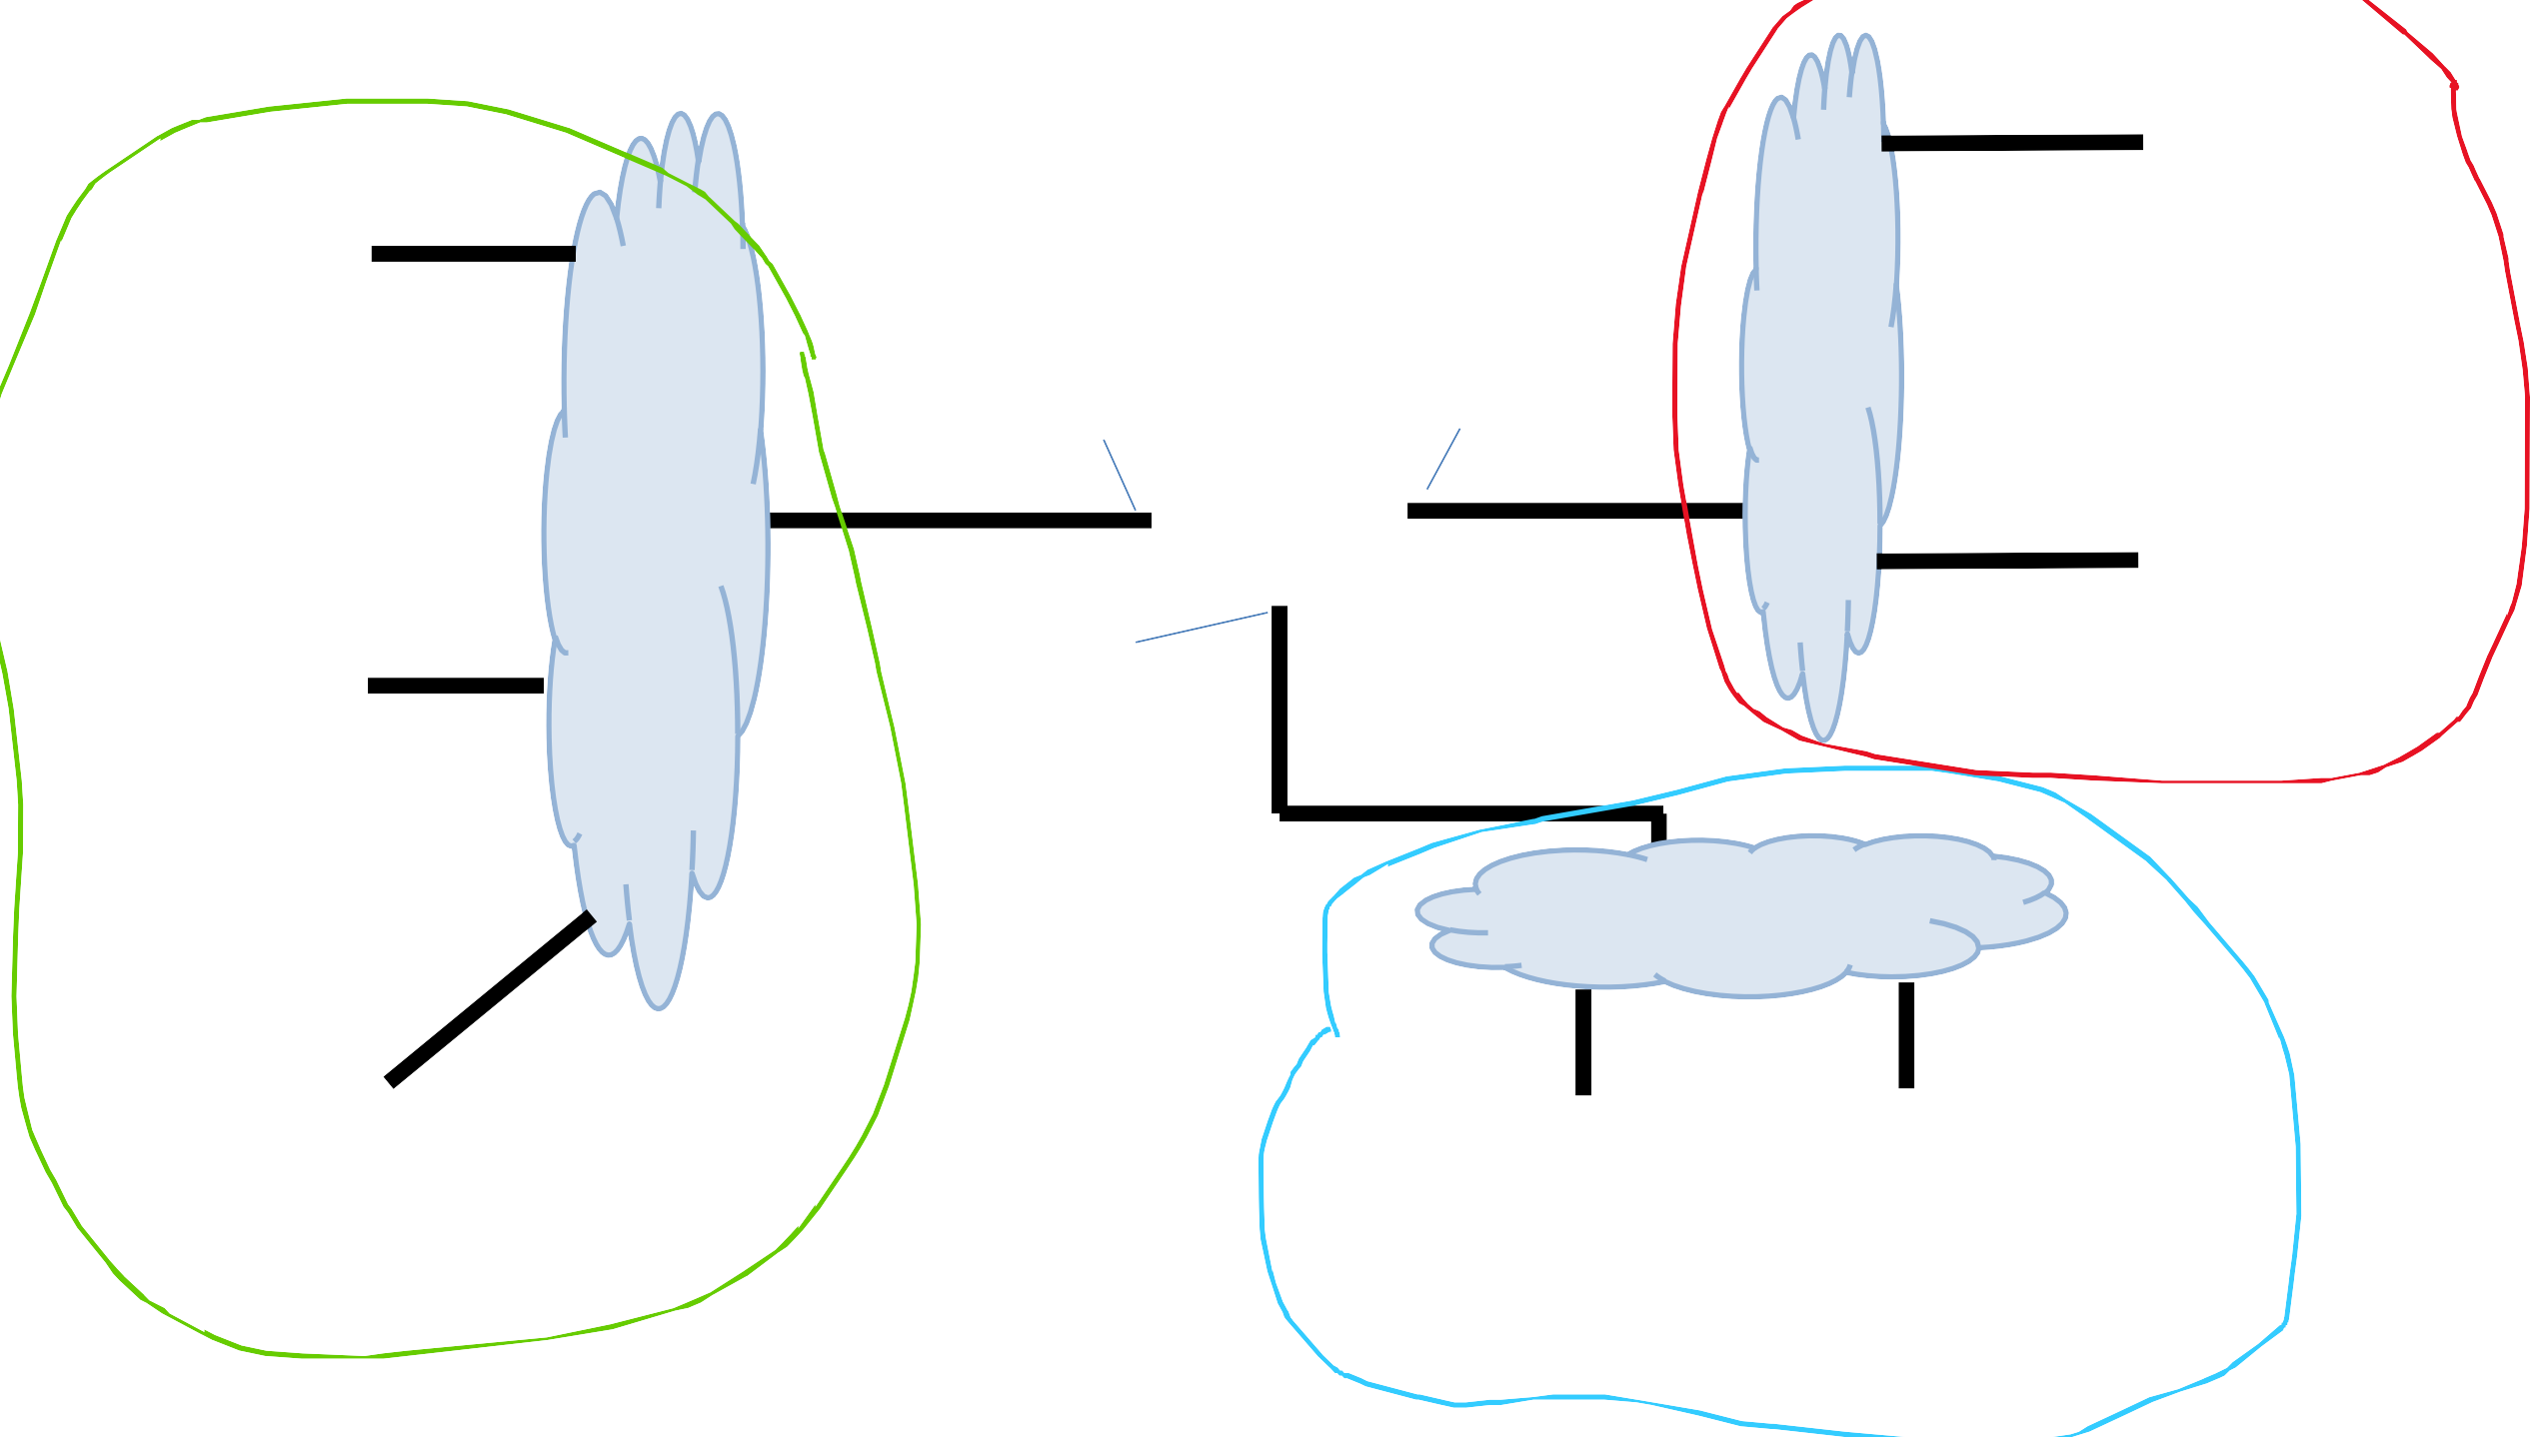
223.1.2.1
Subnet is a logical subdivision of an IP network In this network, we have 3 subnets
223.1.1.1
223.1.1.4
223.1.2.9
223.1.2.2
223.1.3.27
223.1.1.2
223.1.1.3
223.1.3.1
223.1.3.2

Slide 38
Subnet is a logical subdivision of an IP network In this network, we have 3 subnets
Computers usually have 1
interface. Routers have many
223.1.2.1
223.1.1.1
223.1.1.4
223.1.2.9
223.1.2.2
223.1.3.27
223.1.1.2
Devices usually have a private IP address, and a public IP address
IP addresses on the same subnet share a common prefix
Hosts on the same subnet can reach each other without going through a router
223.1.1.3
223.1.3.1
223.1.3.2
38

Slide 39

It is very common to have a range of IP addresses assigned to you (random assignment would be chaos)
Subnet mask
223.1.1.0/24
The leftmost 24 bits represent the prefix of the subnet
11111111 11111111 11111111 XXXXXXXX = 255.255.255.0
223.1.1.1
223.1.1.67
223.2.1.67
223.2.1.255
223.1.1.2
…
193.32.216.9
Network bits
Host bits
223.1.1.253
11000001 00100000 11011000 00001001

Slide 40
Computers usually have 1
interface. Routers have many
Subnet is a logical subdivision of an IP network In this network, we have 3 subnets
223.1.1.0/24 223.1.2.0/24
223.1.3.0/24

Slide 41
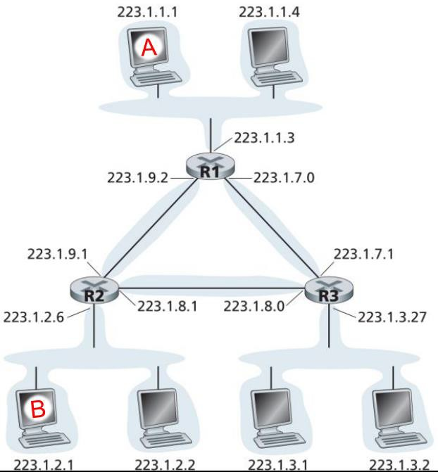





6 subnets
1. 223.1.1.0/24
2. 223.1.7.0/24
3. 223.1.3.0/24
4. 223.1.8.0/24
5. 223.1.2.0/24
6. 223.1.9.0/23

Slide 42
223.1.1.0/24
Managing and Assigning Subnets
The subnet
contains the following addresses
223.1.1.1
223.1.1.2
223.1.1.3
223.1.1.4
223.1.1.5
…
223.1.1.252
223.1.1.253
223.1.1.254
How many addresses does a /24 subnet provide?
0 and 255 are reserved for special services (?)

Slide 43
223.1.1.0/24
Managing and Assigning Subnets
The subnet
contains the following addresses
223.1.1.1
223.1.1.2
223.1.1.3
223.1.1.4
223.1.1.5
…
223.1.1.252
223.1.1.253
223.1.1.254
How many addresses does a /24 subnet provide?
2^8 – 2 = 253
Class C network
0 and 255 are reserved for special services (?)

Slide 44
Managing and Assigning Subnets
Subnet Type | Slash | Subnet Mask | Available Addresses
Class A | /8 | 255.0.0.0 | 2^24 – 2 = 16777216
Class B | /16 | 255.255.0.0 | 2^16 – 2 = 65,634
Class C | /24 | 255.255.255.0 | 2^8 – 2 = 254
Issues with this type of assignment?

Slide 45
Managing and Assigning Subnets
Subnet Type | Slash | Subnet Mask | Available Addresses
Class A | /8 | 255.0.0.0 | 2^24 – 2 = 16777216
Class B | /16 | 255.255.0.0 | 2^16 – 2 = 65,634
Class C | /24 | 255.255.255.0 | 2^8 – 2 = 254
If I have 2000 devices, I will either need 8 class C subnets or 1 class B
subnet (but waste 63,000ish IP addresses)
We need a better way to subnet!

Slide 46
Managing and Assigning Subnets
Our only available subnet masks have been:
255.255.255.0 | 11111111 11111111 11111111 00000000
255.255.0.0 | 11111111 11111111 00000000 00000000
255.0.0.0 | 11111111 00000000 00000000 00000000
/24
/16
/8
CIDR introduces a more flexible way for subnetting We can any number of bits for our mask
Host bits!
200.23.16.0/20 = 11001000.00010111.00010000.00000000
Mask = 11111111.11111111.11110000.00000000

Slide 47
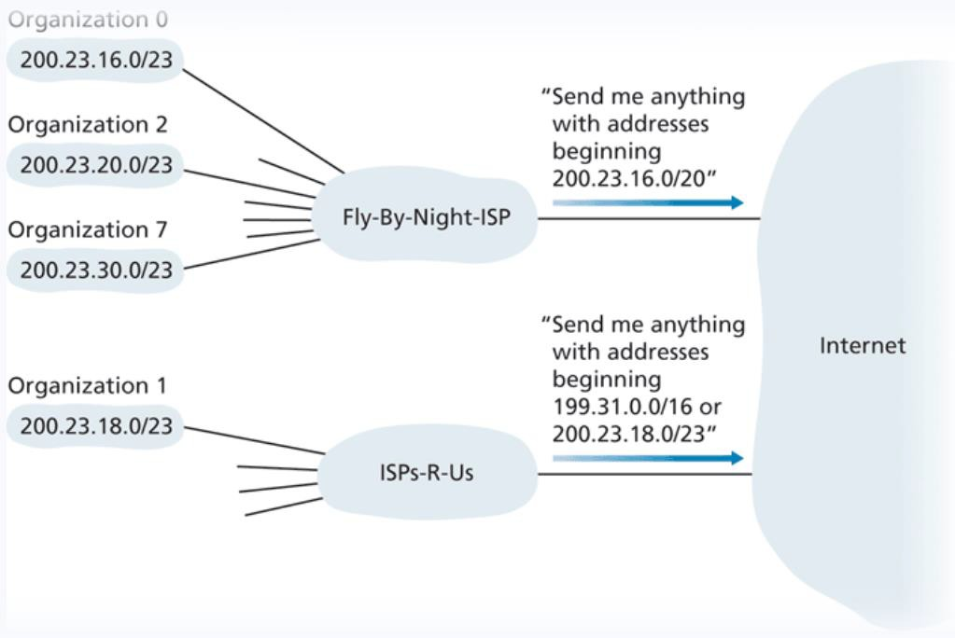
ISPs can now group and advertise organizations by IP blocks
We once again have another hierarchy ☺

Slide 48
One possible way an ISP could organize IP blocks
ISP’s block | 200.23.16.0/20 | 11001000 00010111 00010000 00000000
Organization 0 | 200.23.16.0/23 | 11001000 00010111 00010000 00000000
Organization 1 | 200.23.18.0/23 | 11001000 00010111 00010010 00000000
Organization 2 | 200.23.20.0/23 | 11001000 00010111 00010100 00000000
…
Organization 7 | 200.23.30.0.23 | 11001000 00010111 00011110 00000000

Slide 49
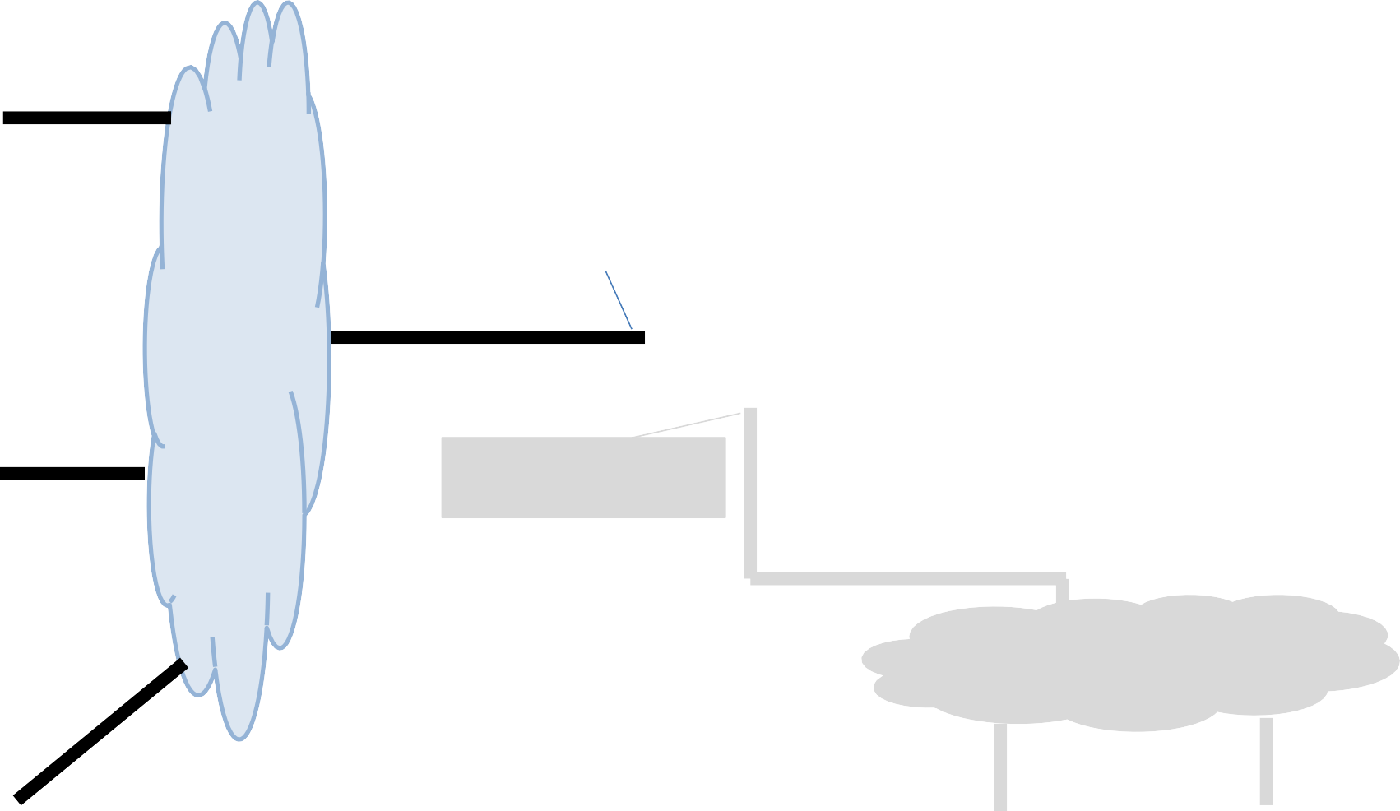
Devices on the same subnet communicate with each other by broadcasting a special message
This special message is when the source IP address of some packet is 255.255.255.255
223.1.1.4
223.1.1.1
223.1.3.27
223.1.1.2
223.1.1.3
223.1.3.1
223.1.3.2

Slide 50
Devices on the same subnet communicate with each other by broadcasting a special message
255.255.255.255
This special message is when the source IP address of some packet is 255.255.255.255
223.1.1.1
223.1.1.4
(This request can sometimes be echoed to
neighboring subnets)
223.1.3.27
223.1.1.2
223.1.1.3
223.1.3.1
223.1.3.2

Slide 51
How do IPs get obtained/assigned?
The Internet Corporation for Assigned Names and Numbers (ICANN) is responsible for managing and allocating IP address space for ISPs and organizations
(they also manage the DNS root servers!)
When an organization gets a range of IP addresses to use, how to we give assign them to devices?
Do we do it manually?
we could….

Slide 52
DHCP
Dynamic Host Configuration Protocol (DHCP) is a plug-and-play, client-server protocol that allows a host to obtain an IP address automatically
When a host is automatically assigned an IP address, it might keep that one forever, or the IP addresses can be temporary
(more common)

Slide 53
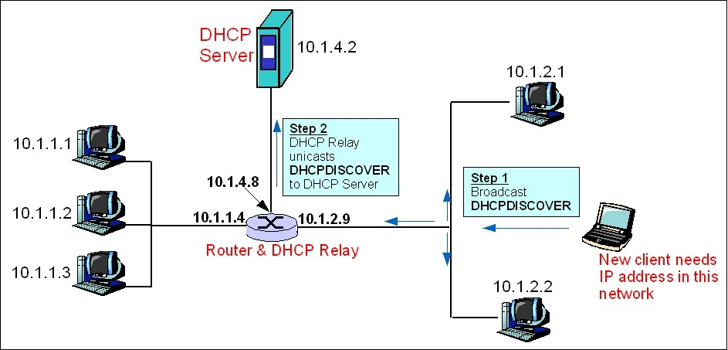

This process is similar to a TCP handshake!
Broadcast gets sent to all devices on the subnet!!
But devices that are not the dhcp server will ignore it

Slide 54
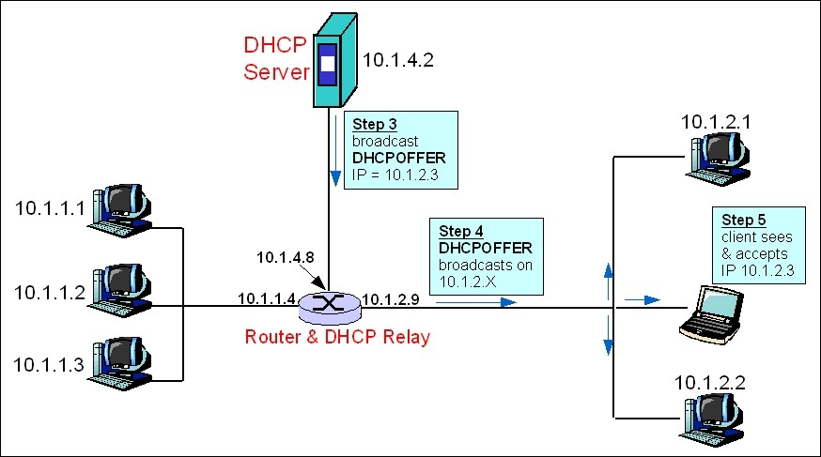
This process is similar to a TCP handshake!

Slide 55
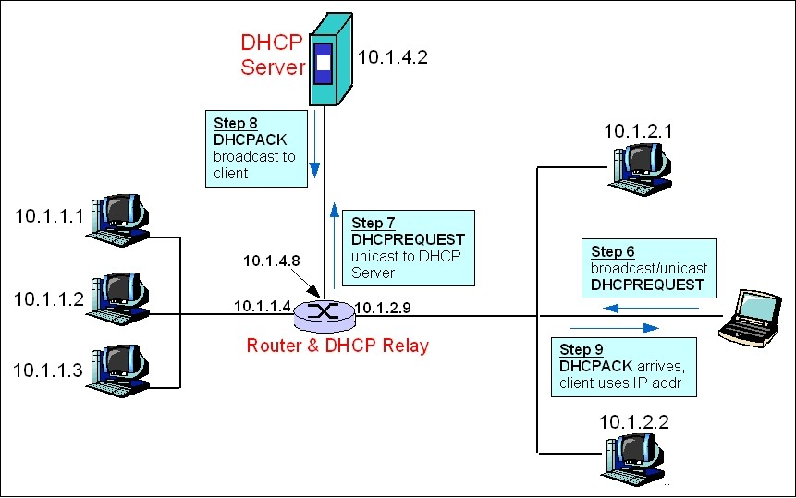
This process is similar to a TCP handshake!

Slide 56
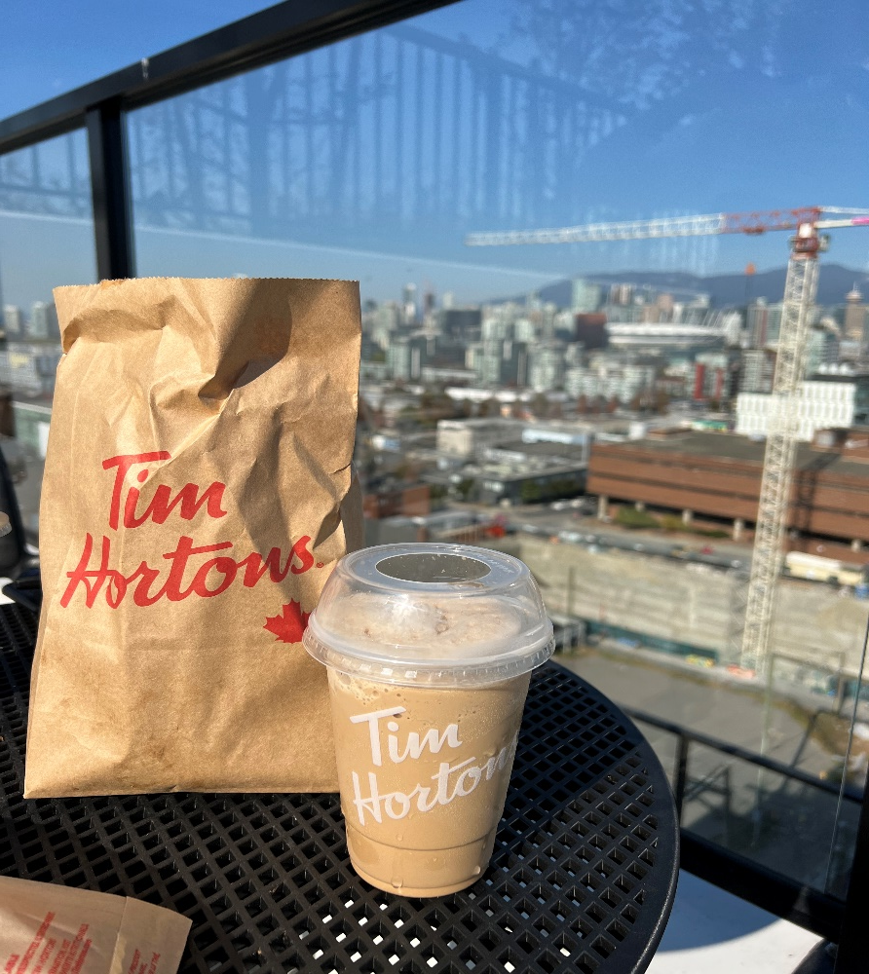


Announcements
If I haven’t responded to a DM/email, please poke me about it
PA2 due on Friday 10/21
I will allow you to submit it any time this weekend with no late penalty (no late pass required!)
Lecture will be asynchronous (recorded) on Monday
PA2: Flow Demo, FIN ACKs

Slide 57
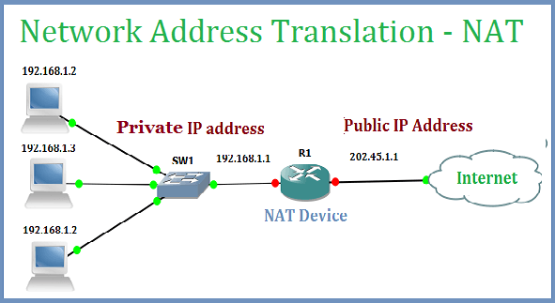
NAT (Network Address Translation)
NAT is a translation of multiple private IP addresses to one single public IP address

Slide 58
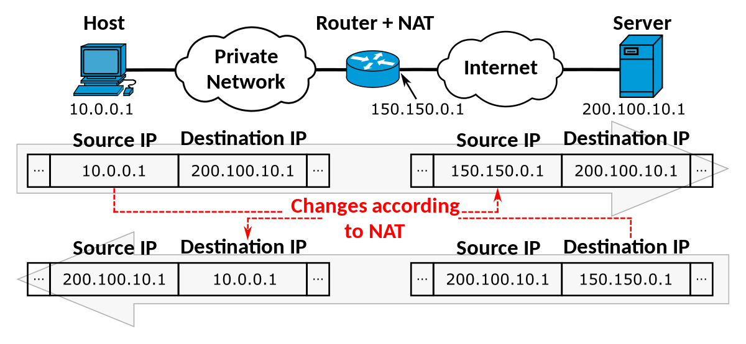

NAT (Network Address Translation)
NAT is a translation of multiple private IP addresses to one single public IP address
Hides details of inner home network from outside world
All incoming traffic will have same public IP, all outgoing will have same public IP
Routers get assigned their one public IP address through DHCP!

Slide 59
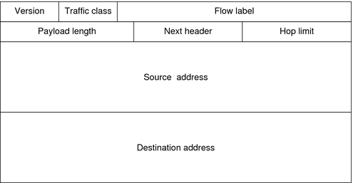
Packets traversing through the network layer are referred to as a datagram. Each packet gets an IPv4/IPv6 header
Transport Layer Header
IP Header
Message
Transport
Layer Header
TCP header = 20 bytes IP header = 20 bytes
Message
IPv6 = 128 bits
(not 64)
IPv6 Header
(128 bits)
(128 bits)
The goal is for our internet to be only using IPv6 in the near future? Issues?

Slide 60
Tunneling
A
B
IPv4 tunnel
connecting IPv6 routers
E
F
logical view:
IPv6
IPv6
IPv6
IPv6
A
B
C
D
E
F
physical view:
IPv6
IPv6
IPv4
IPv4
IPv6
IPv6
flow: X
src: A
dest: F
data
src:B
dest: E
src:B
dest: E
flow: X
src: A
dest: F
data
Flow: X
Src: A
Dest: F
data
Flow: X
Src: A
Dest: F
data
A-to-B:
IPv6
B-to-C:
IPv6 inside
IPv4
E-to-F:
IPv6
B-to-C:
IPv6 inside
IPv4
4-60

Slide 61
Generalized Forwarding and Software Defines Network (SDN)
So far, a router takes input from input port, and then outputs on some output port
What else might a router need to do?

Slide 62
Generalized Forwarding and Software Defines Network (SDN)
So far, a router takes input from input port, and then outputs on some output port
What else might a router need to do?
Forward, Drop stuff, Modify, Load balance
We need more flexibility and functionality with our forwarding!!

Slide 63
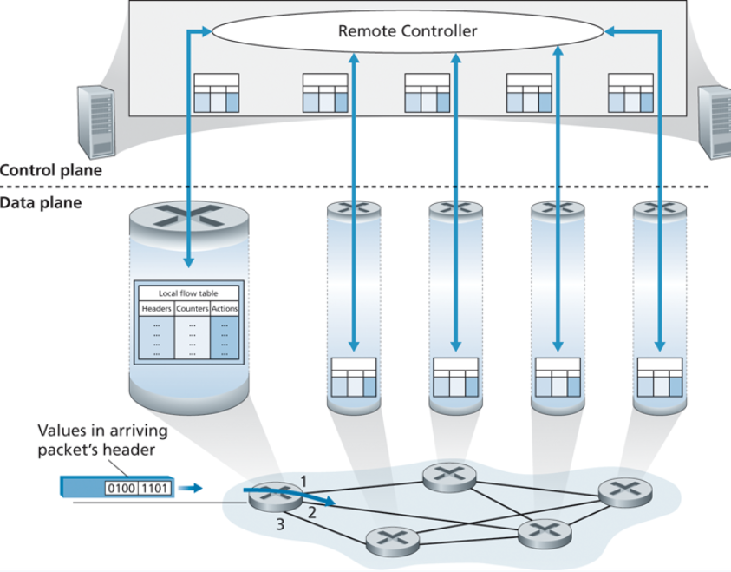
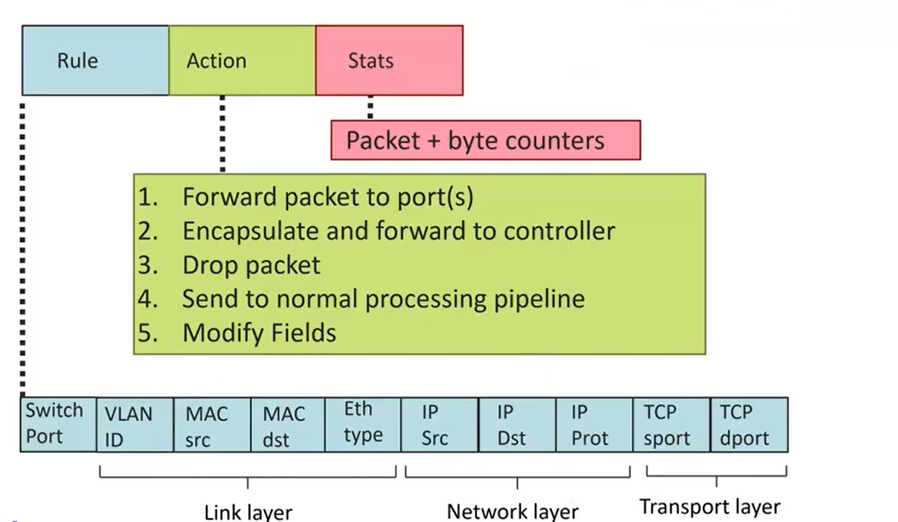
Generalized Forwarding and Software Defines Network (SDN)
OpenFlow standard
We need headers/rules, which are going to the values the remote controller is going to evaluate
We need actions to do based on some pattern match

Slide 64
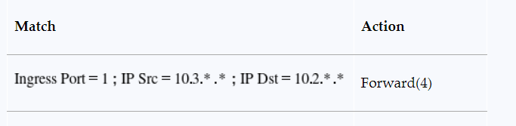
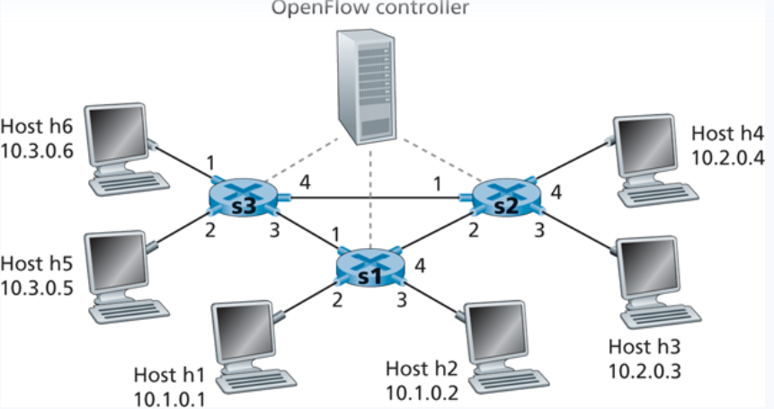
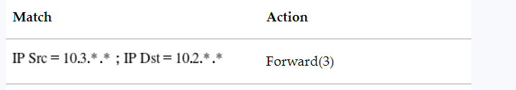
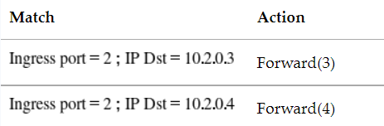


Generalized Forwarding and Software Defines Network (SDN)

Slide 65
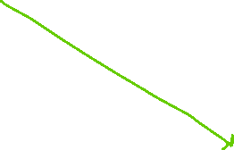


Generalized Forwarding and Software Defines Network (SDN)

Slide 66
Generalized Forwarding and Software Defines Network (SDN)

Slide 67


Generalized Forwarding and Software Defines Network (SDN)

Slide 68
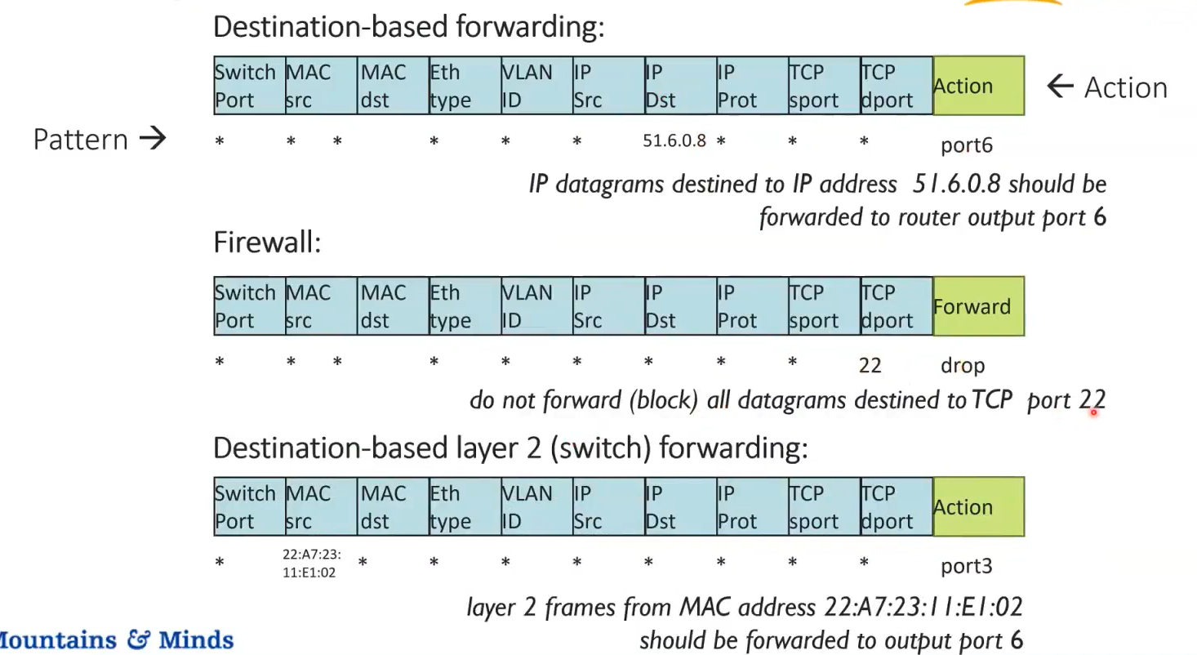
Generalized Forwarding and Software Defines Network (SDN)
22

